Slide 1
Introduction to i-THRIVE
“If we keep on doing what we have been doing, we are going to keep on getting what we have been getting”

Slide 2
Alignment of i-THRIVE to national strategies
CAMHS transformation/ Future in Mind
NHS five year forward view
Sustainability and Transformation plans

Slide 3
“Future in Mind”* identifies specific challenges with our current Child & Adolescent Mental Health Services
Treatment gap: only 25% - 35% young people who need support access services, with increasing levels of need in some groups e.g. eating disorders
Difficulty with access: benchmarking shows an increase in the number of referrals and length of waiting times. Waiting times are around 3 weeks for crises and 18 weeks for routine; out of hour liaison very variable
Complex commissioning arrangements: lack of clear accountability between providers, especially between CCGs and Local Authority
Worse care for vulnerable groups: they find it hard to access services
Gaps in data collection: lack of useful data and information, and there have been delays in developing payment and other incentive systems
* Future In Mind: Department of Health & NHS England Joint Taskforce Report on CAMHS, 2015.

Slide 4
How THRIVE Addresses the Problem
Whole system approach focusing on needs and preferences
Builds on & draws from community resources, and individual’s resources to create a diverse range of options for care
Shared decision making and preference sensitive are core principles
Identifies resource-homogenous groups of young people with common needs and preferences, rather than an escalator/severity approach
Focus on early intervention & building resilience in young people & families
THRIVE advocates the effective use of data to inform service delivery and meet needs

Slide 5
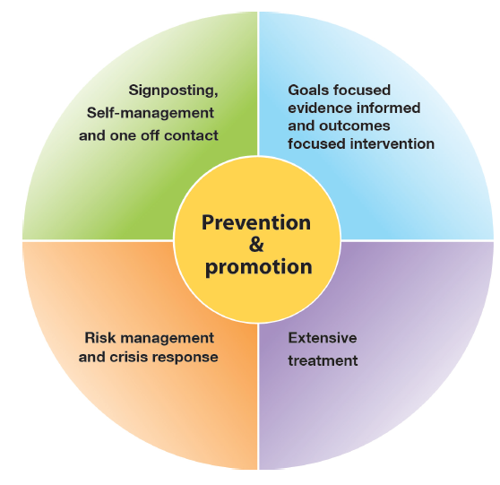
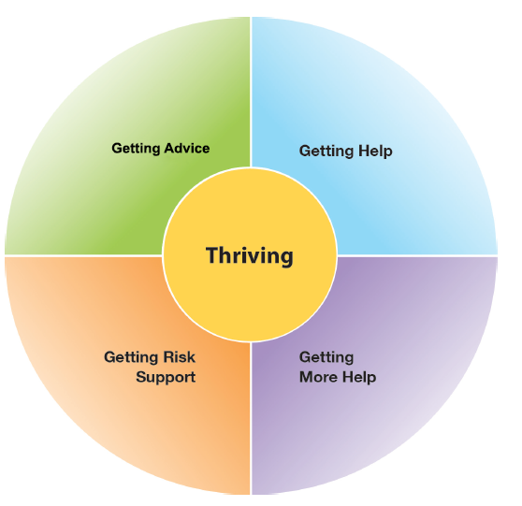
The THRIVE Conceptual Framework
Input offered
Description of the THRIVE-Groups
Five Needs Based Groups are distinct in terms of the:
needs and/or choices of the individuals within each group
skill mix of professionals required to meet these needs
resources required to meet the needs and/or choices of people in that group
Starting point is always shared decision making
Notes:
THRIVE is a needs based model that enables care to be provided according to four distinct groupings, determined by a patient’s needs and preferences for care
Emphasis is placed on prevention and the promotion of mental health and wellbeing
Patients are empowered to be actively involved in decisions about their care through shared decision making (SDM)
THRIVE is complimentary to successful existing models e.g. CAPA and CYP IAPT
It provides a clearer distinction than before between:
treatment and support
self-management and intervention
more systematic integration of shared decision making and routine collection of preference data

Slide 6
i-THRIVE (Implementing-THRIVE)
Implementing-THRIVE
i-THRIVE is the translation of THRIVE into a model that can be implemented
i-THRIVE was selected to be a national NHS Innovation Accelerator, led by Anna Moore.
The i-THRIVE partnership has been created between the Anna Freud Centre, Tavistock & Portman NHS Foundation Trust, Dartmouth Centre for Healthcare Delivery Science and UCLPartners.

Slide 7
Implementing THRIVE at the different system ‘levels’
Whole-system (Macro)
Considering Population Health Improvement
Agencies working together
commissioning services
Group (MESO)
Needs-based groups
The services/ teams that enable delivery of care according to those needs
Individual (MICRO)
Working with young people and their families
Professionals working together collaboratively

Slide 8
Characteristics of a THRIVE-like service: Macro level
All agencies are involved (education, health, social care, third sector)
Mental health policy is interagency
CYP mental health forms part of the JSNA
Data about patient preferences are used to inform resource allocation and commissioning decisions
Quality Improvement (QI) approaches are used to inform commissioning and contracts

Slide 9
Characteristics of a THRIVE-like service: Meso-level
Help is delivered using a conceptual framework of 5 needs-based groups
Evidence based practice is available and aligned to need
There is a comprehensive network of community providers
There is a focus on strengths and family resources wherever possible
Data is used to inform decisions (meeting using MINDFUL approach and involving multiagency review and individual practice work)
QI is used to inform service or team development

Slide 10
Characteristics of a THRIVE-like service: Micro-level
Shared decision making is at the heart of all decisions
People (staff, CYP and families) are clear which needs-based group they are working within for any one person at any one time and this explicit to all
Any treatment involves explicit agreement from the beginning about the outcome being worked towards and the likely timeframe. There would be a plan for what happens if it is not achieved
People (staff, CYP and families) are clear about parameters for help and reasons for ending
The most experienced practitioners inform advice and signposting
THRIVE plans are used to help those managing risk
QI is used to inform individual practice

Slide 11
The needs group: Getting Advice & Signposting
Simplified, holistic assessment and formulation process considers the problems that the young person considers to be their biggest concerns
Considers if the young person prefers active treatment, or if advice and signposting is their preferred option
Includes consideration of services/resources in the community, LA, 3rd sector, within the YP’s personal networks as well as medical options
Considers the young person’s preferred way of accessing help – digital, peer support, self help
A directory or app of local and digital options offered including peer support and self help
Co-ordinated network of providers – relationships and processes
Programmes which engage and target hard to reach groups easily accessible.
Multi-agency
Highly skilled staff

Slide 12
The needs group: Getting Help & Getting More Help
Treatment under pinned by Best Practice e.g. NICE Guidelines, CYP IYAPT.
Electronic patient record in place.
Rigorous outcome monitoring to inform practice.
Care delivered by a range of practitioners.
Care not necessarily delivered by health provider
Range of ways to access care – digital, groups, face to face
Shared decision making embedded.
Clear treatment outcomes/goals and timescales defined at the beginning of the intervention and used to inform practice

Slide 13
The needs groups: Getting Risk Support
Integrated Multi-agency approach with joint outcomes and joint accountability for these
Documented thrive plans developed in partnership with children young people and their families. Two coordinators, one chosen by YP/family
Developing a personal support network and outcomes which are realistic/appropriate
Aims to have fewer professionals to relate to
AMBIT: Adolescent mentalisation based integrative treatment
Measure how well Integrated services are (IntegRATE measure)

Slide 14
Components of the i-THRIVE Model of Care
Core THRIVE principles delivered using evidence based approaches to delivery that fit local context
Needs based care (not severity or diagnosis led)
Shared decision making at each point in pathway
Integration: multiagency teams that are trained and located together, with common processes and outcome frameworks
Training clinicians in clarity about when treatment is being provided vs. support, promoting & supporting self help, shared decision making
Community of Practice building on existing funded work with 10 sites – natural route for dissemination
Getting Advice & Signposting
Getting Help
Digital ‘front – end’
Short, evidence based interventions aligned with NICE Guidance
Single point of access with multi-agency assessment & effective signposting
Creating a comprehensive network of community providers: Youth Wellbeing Directory
CYP IAPT
Wide variety of choice of modality and location, provided by health or alternatives (3rd sector, community providers)
Outreach to Hard-to-reach groups
Schools and primary care in-reach
Self-help and peer-support
Outcomes plus goal based measures
AMBiT: Integrated multi-agency approach with joint accountability for outcomes
Longer, evidence based interventions
Safety plans co-produced between agencies & young people
CYP IAPT
Provided by health primarily
Emphasis on developing Personal support network
Self-help and peer-support
Outcomes plus goal based measures
Risk Support
Getting More Help
(with thanks to Anna Moore)
Notes:
THRIVE is the conceptual framework that will help us move to the ‘next’ world where……
In an integrated care model we need to…….

Slide 15
i-THRIVE approach to implementation
Creating change is challenging, no matter how good the innovation
i-THRIVE as an aggregator
We encourage an evidence-based approach to implementation informed by implementation science

Slide 16
Taking an evidenced based approach to implementation with the Quality Implementation Framework
Self Assessment
Needs Assessment
Fit Assessment
Capacity/Readiness
Assessment
Decisions about
adaptation to fit
Context
Prioritisation
Structural features of Implementation
Finalising Implementation
Plan
Developing Implementation Teams
Community of Practice
Training Clinical & Professional Teams
Measurement in place
Phase 1
Phase 2
Creating Structure for Implementation
Initial considerations
Learning from
Experience
Sustainability
Normalisation
Process Theory
Ongoing Implementation Support Strategies
Technical Assistance/Coaching/Supervision
Ongoing Training
Process Evaluation
Supportive Feedback Mechanisms
Phase 4
Phase 3
Ongoing Structure Supporting Implementation
Improving future applications
Notes:
In implementing THRIVE we are following a structured evidence based approach recommended by Meier. It has 4 phases, which are as above.

Slide 17
i-THRIVE Community of Practice
The i-THRIVE Community of Practice is a group of organisations sharing learning about the implementation of i-THRIVE. They are supported by the i-THRIVE Partnership, which provides support through the key workstreams below.
i-THRIVE Illustrated
i-THRIVE Academy
i-THRIVE Implemented
Sharing examples of ‘THRIVE-like’ practice, drawing on good practice from members of the i-THRIVE Community of Practice currently implementing the model.
Education and training programmes to build capacity & competency supporting delivery of transformation. Shared learning events, Action Learning Sets and webinars.
Includes training practitioners, leaders & commissioners.
Providing an evidence based approach to transformation, implementation & dissemination of best practice, supported by the i-THRIVE Toolkit.

Slide 18
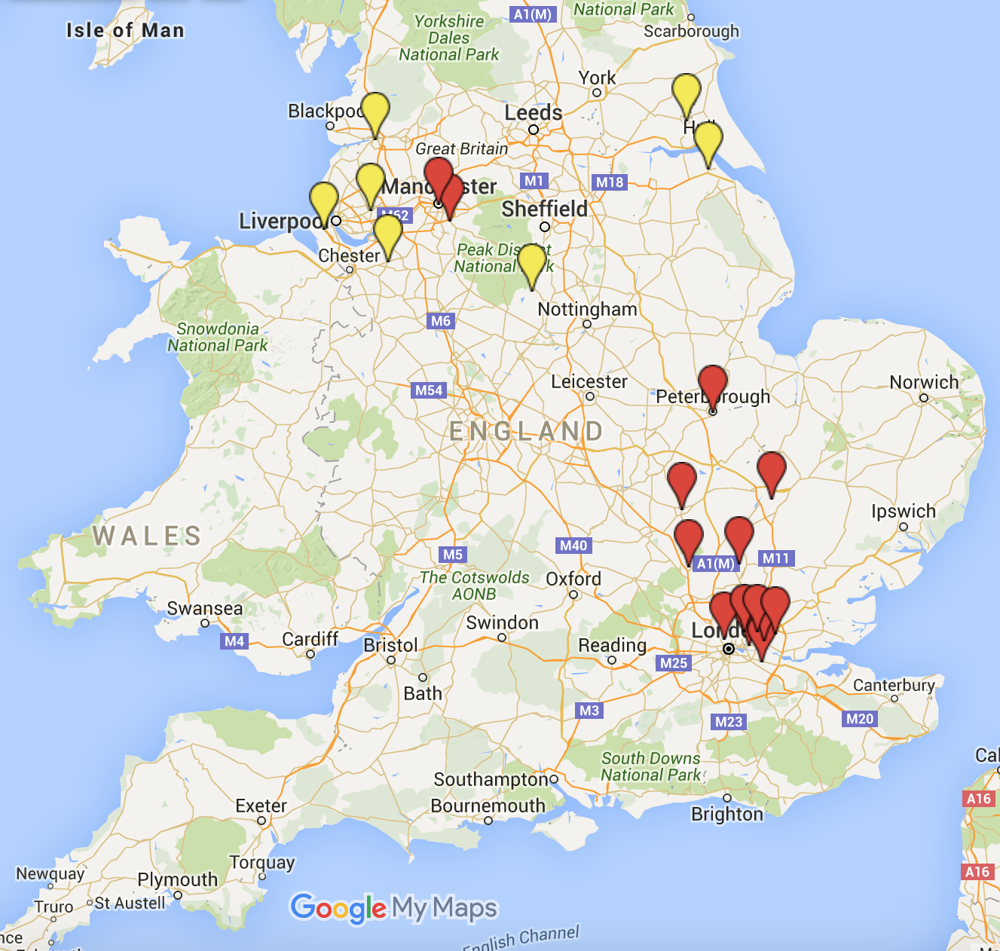
The i-THRIVE Community of Practice
~20% of CYP Population
COP only
Accelerators

Slide 19
The i-THRIVE Partnership
The Anna Freud National Centre for Children and Families
http://www.annafreud.org/
The Tavistock and Portman NHS Foundation Trust
https://tavistockandportman.nhs.uk/
The Dartmouth Centre for Health Care Delivery Science
http://tdchcds.dartmouth.edu/
UCLPartners
http://www.uclpartners.com/

Slide 20
Why it matters?
“If I’d only had in my teens what I’ve had in my thirties, perhaps I wouldn’t have lost my twenties.”
Mental health service user
Notes:
Is it important? It is… because the average experience is what this person describes….
The 6% of what we give them is inefficient. The 8% is closer to whats needed, but lets make sure the extra 2% delivers what these people really wanted.

Slide 21
For more information
Dr. Anna Moore: i-THRIVE Implementation Lead & National NHS Innovation Accelerator Fellow
a.moore@ucl.ac.uk
Dr. Miranda Wolpert: First author of the THRIVE Conceptual Framework
miranda.Wolpert@annafreud.org

